Slide 1
Finding Parking Spots in a Parking lot
Using OpenCV and Machine Learning

Slide 3
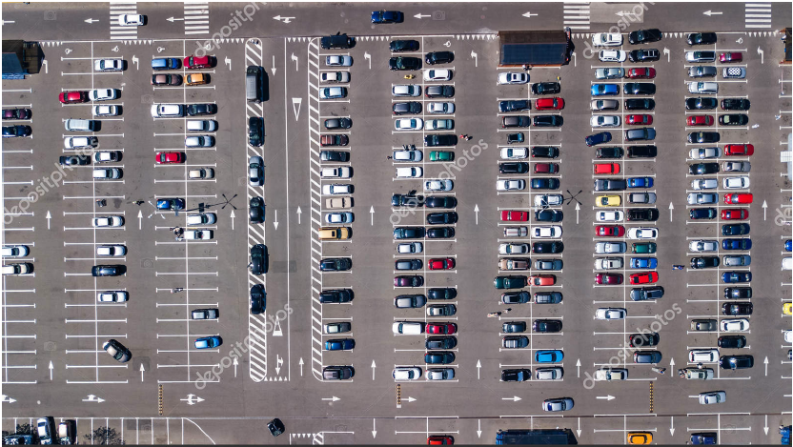
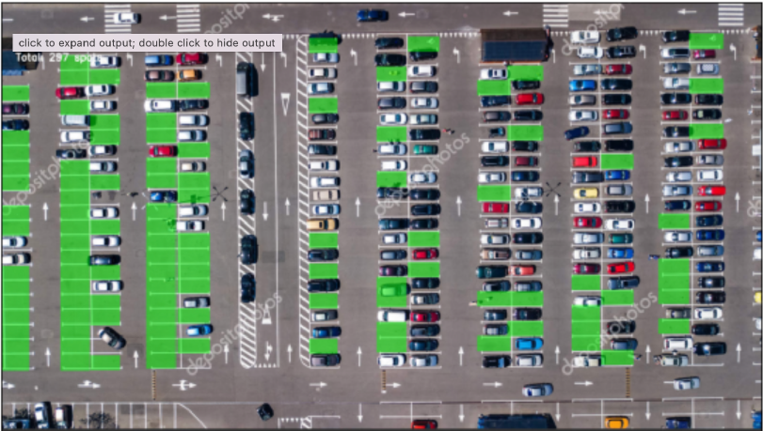
Lets take a look at the input and desired output once again.

Slide 4
Summary of the Methodology
Spotting the parking spaces in the parking plot using OpenCV. Each parking spot is taken out as an image!
Training a machine learning model that is able to recognize whether there is a car in an image or not
Whether a parking space contains a car or not!
Using OpenCV, the given image was considered and each of the parking space was carved out as a single image.
Simultaneously, a machine learning model was developed with Keras that was trained on the data. The objective was set to recognize whether, in a given image, a car exists or not.
Finally, the Machine learning is deployed against each of the carved out image and used to classify each as a vacant parking space or already taken up.

Slide 5
Lets dive in further into each of the steps taken alongside a walk thought the code that is used to create the system
As explained in the figure shown in the last slide, the system will be made using two independent procedures. One is to conduct parking slots’ recognition from a given image. Other is to make predictions on the slots using Artificial Intelligence

Slide 6
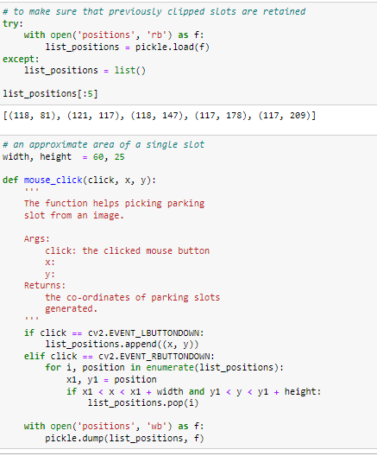
Carving out of the coordinates of parking slots from parking lot
The technique used here consisted of taking out snippets for parking spaces in the parking lot. This is performed using OpenCV. An approximate size of parking slot is 60*25
To achieve this, a function is created called mouse_click. For each left click, a parking slot is carved out. Whereas the right click can be used to undo the action of the left click. The right click has to be made within carved out parking slot by the preceding left click.
The co-ordinates are saved in a file called positions and dumped in it using pickle, such that the process does not need to be repeated again. As expected, the file is accessed using a try-except clause to restore the saved coordinates

Slide 7
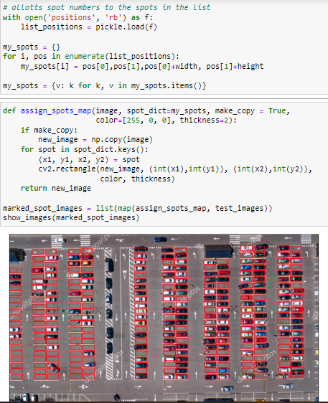
Allotting parking slot numbers and taking a view
The saved coordinates in the file positions are given numbers for identification and later to be used as test images against the model.
A function called assign_spots_map is created. The purpose of the function is to realize the coordinates picked up by mouse_click, stored in file positions and numbered in my_spots to the input parking image.
Aesthetics such as border color, size, thickness can be modified using the parameters of the function.
The output reaffirms the identification of the parking slots.
The spots alongside their labels are dumped in a file called my_spots using pickle.

Slide 8
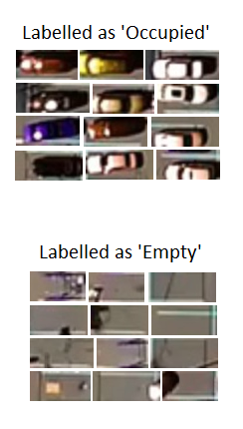
A peek into the Data used for model training
The aim for which Machine Learning is used is the recognition of an object as car or ‘not a car’ in a given image.
Therefore, the data required to be used for the purpose did not has to be complicated. A very simple dataset contain aerial shots of a surface was suffice. As the purpose as just to train a model that is able to recognize whether a car is present in an image or not.
One of the benefits of using Machine Learning approach over traditional CV methods is that having been trained on such data, the machine learning model will try to go declare a slot as full only when it detects a complete view of a car. In any other case, it will still mark the spot as vacant. Whereas in most of the commonly used CV approaches, an image that is ‘too full’ could be marked as if there is a car, hence, not vacant.

Slide 9
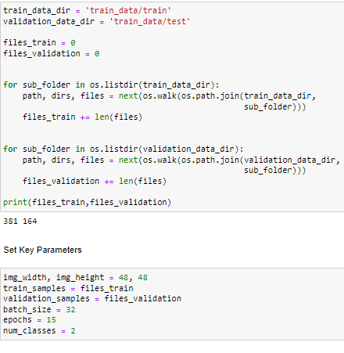
Reading the data in
The data is stored in the current working directory in a way in the first directory, train and validation folders and each of train and validation folders contain two subfolders of occupied and empty images.
The data, stored in the current working directory, is read from the directories using a for loop.
Important parameters such as dimensions of the image, train_samples, validation_samples, batch_size, epochs, and the number of classes are defined

Slide 10
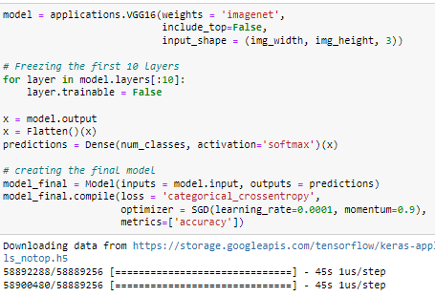
Into the model building
Basically, VGG16 model pretrained on ImageNet dataset is used. To keep it simple, 3 fully-connected layers are excluded. First 10 layers are also froze in order to accelerate the training process.
After flattening outputs into single dimensions, a dense layer is used of 2 units with Softmax as activation function.
The final model in instantiated and compiled with categorical cross-entropy as loss function, SGD as optimizer, and accuracy as the learning metric.

Slide 11
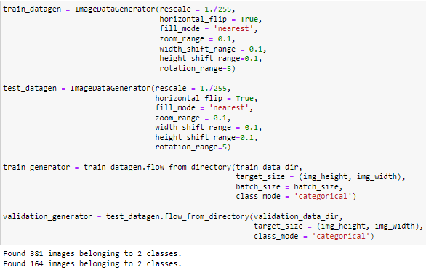
Data Augmentation and Generation
To expand the dataset and add some variety to it, data augmentation can be used using ImageDataGenerator Class.
Using horizontal flips, filling with nearest element, zooming, shifting ranges and rotation, the data augmentation is achieved to a good extent.
To continue with augmentation while the data is training, the method flow_from_directory is utilized as well

Slide 12
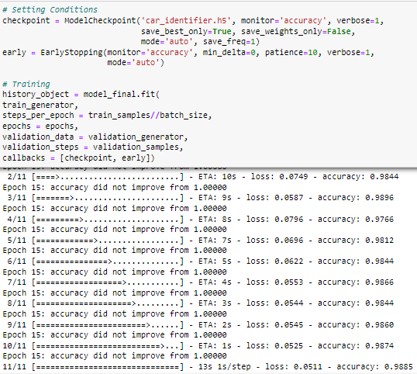
Training the model
The ModelCheckpoint class is used to train the model as it provides some additional features such as whether to save the ‘best performing’ model or to save model at the end of each epoch.
The monitor parameter can be used to describe the ‘performance’, hence, it helps determining the best performing model.
To terminate the training if accuracy does not improve, another callback of EarlyStopping is also introduced.
Finally, the model is fit using various parameters. The accuracy score is nearly perfect while the loss is almost negligible.
The model is saved as ‘car_identifier.h5’ and ready to make predictions with.

Slide 13
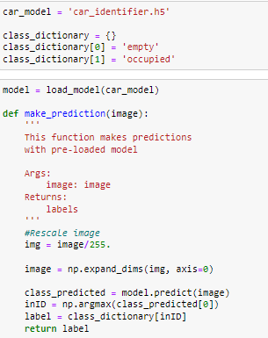
Towards making the prediction
The saved model is loaded.
A function is made up to make predictions and return the label.
The image to be predicted is used as an input, rescaled. Further, image’s arrays’ dimensions are expanded using numpy’s expand_dim.
Within the function, prediction is called on the image. The label is returned using numpy’s argmax.

Slide 14
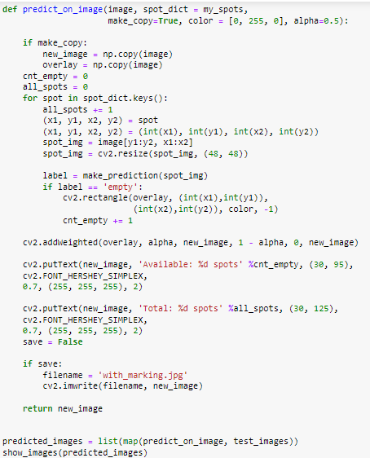
Making Prediction
To integrate our prediction that is still a label to the full fledged parking plot, another function is introduced.
It takes the image under question, information about parking spots dimensions that were designated labels, color to be used etc.
The spots are realized on the image, and a prediction is made on each spot one after another, using a for loop.
If image is empty, it is highlighted using a green overlay and count of available spaces is increased by 1.
The counter, shown on the top left gives the number of parking spaces available.
The image is saved.

Slide 15
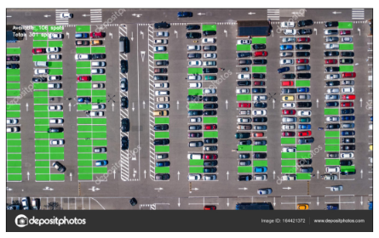
Prediction turned into Result!

